Slide 1
Edges and corners CS B657 Spring 2017

Slide 2


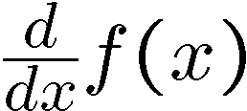
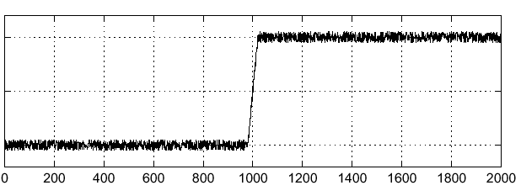
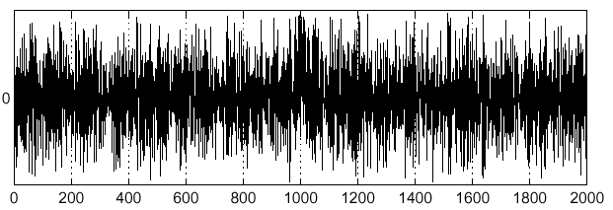
Effects of noise
Noisy input image
Where is the edge?
Source: S. Seitz
Notes:
How to fix?

Slide 3
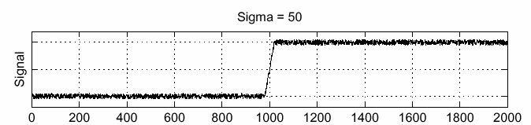
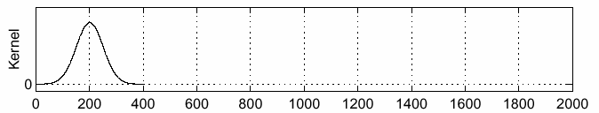
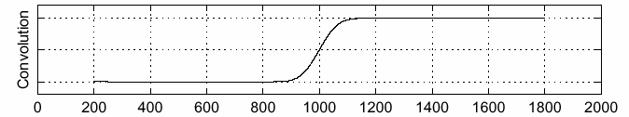
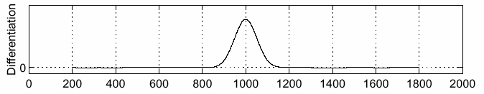
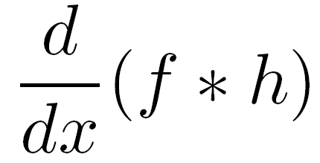
Solution: smooth first
f
h
f * h
To find edges, look for peaks in
Source: S. Seitz

Slide 4
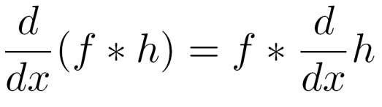
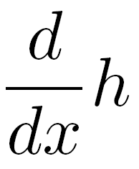
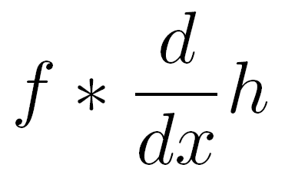
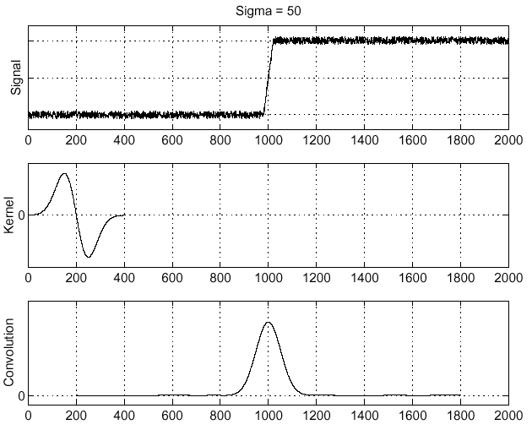
A simpler solution
A useful identity:
This saves us one operation:
f
Source: S. Seitz

Slide 5
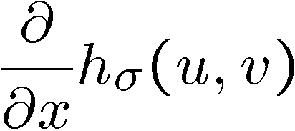
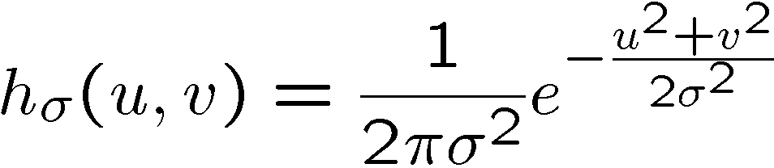
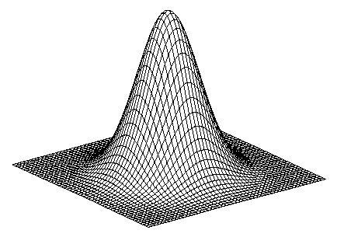
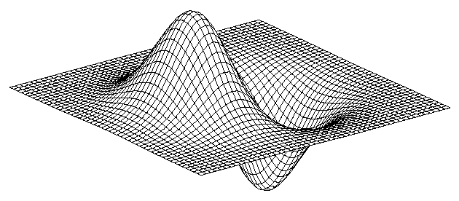
2D edge detection filters
derivative of Gaussian (x)
Gaussian
Notes:
How many 2nd derivative filters are there? There are four 2nd partial derivative filters.
In practice, it’s handy to define a single 2nd derivative filter—the Laplacian

Slide 6
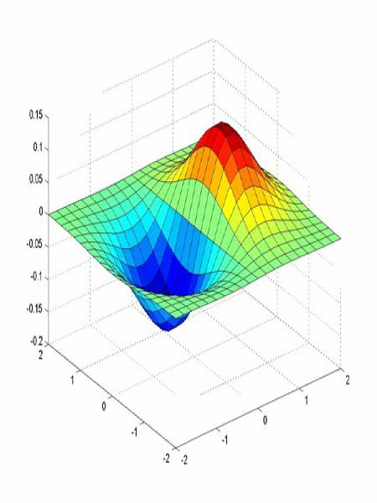
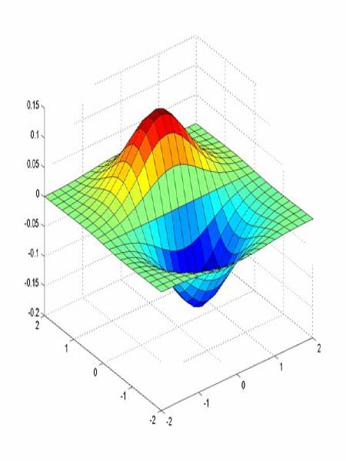
Derivative of Gaussian filter
x-direction
y-direction

Slide 7



The Sobel operator
Common approximation of derivative of Gaussian
-1 | 0 | 1
-2 | 0 | 2
-1 | 0 | 1
1 | 2 | 1
0 | 0 | 0
-1 | -2 | -1
Notes:
7
Q: Why might these work better?
A: more stable when there is noise

Slide 8
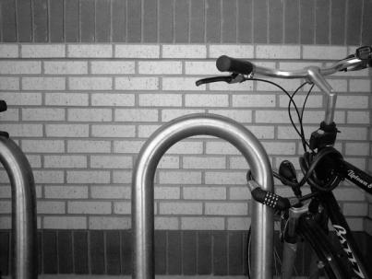
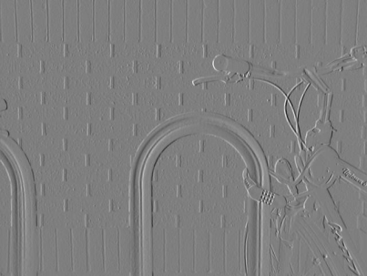
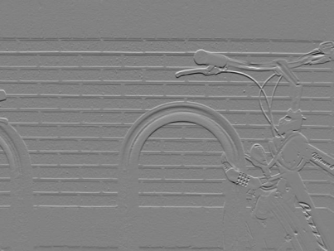
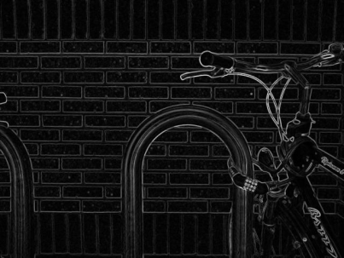

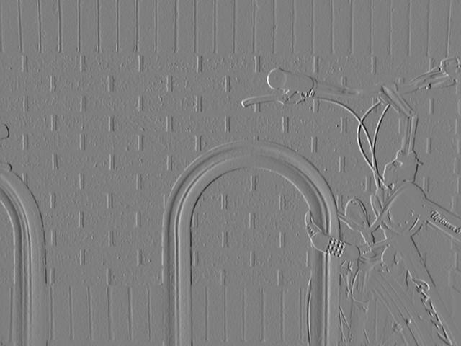
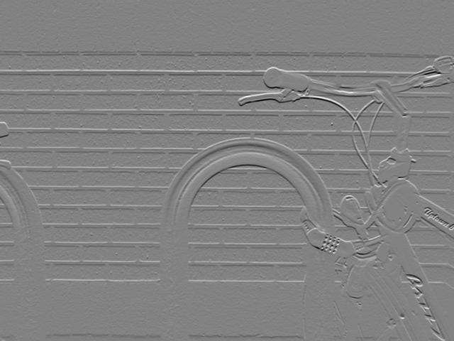
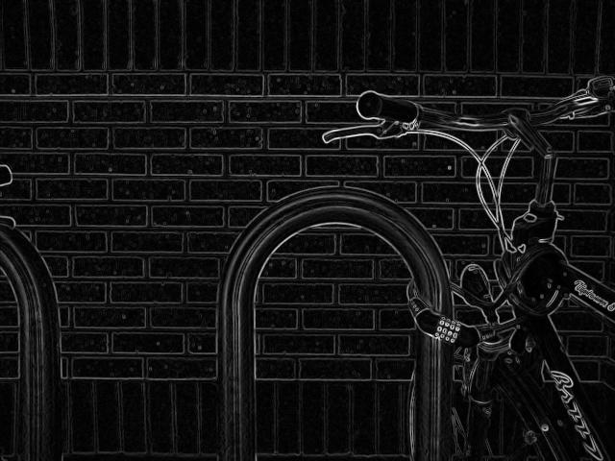
Sobel operator: example
Source: Wikipedia

Slide 9

Example
original image (Lena)

Slide 10
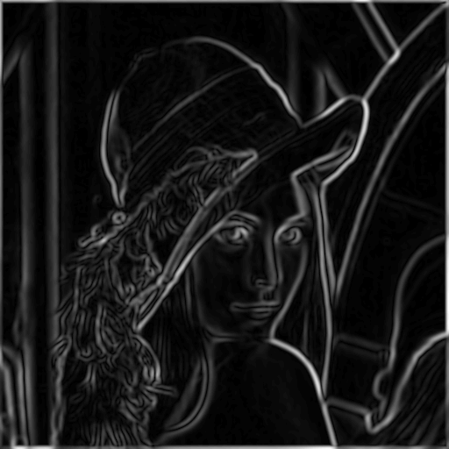
Finding edges
gradient magnitude

Slide 11
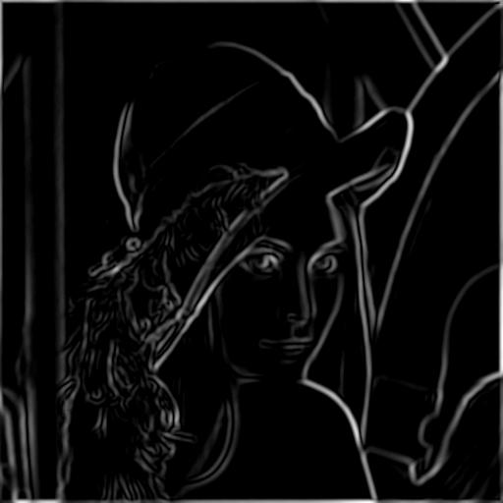
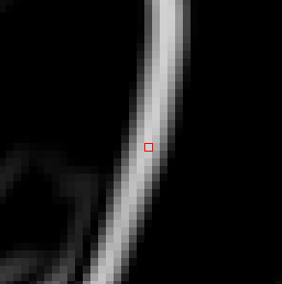
Finding edges
useful edges
disappeared
Multiple detections
thresholding

Slide 12
What makes a good edge detector?
Goals for edge detection
Minimize rate of multiple detection (2 pixels classified as edges that correspond to same image edge)
Minimize probability of false detection
Minimize distance between reported edge and true edge location
Canny (1986) studied these criteria
Showed that derivative of Gaussian is optimal (in 1D)
Developed heuristics for satisfying criteria in 2D

Slide 13

Non-maximum suppression
Check if pixel is local maximum along gradient direction
requires interpolating pixels p and r

Slide 14
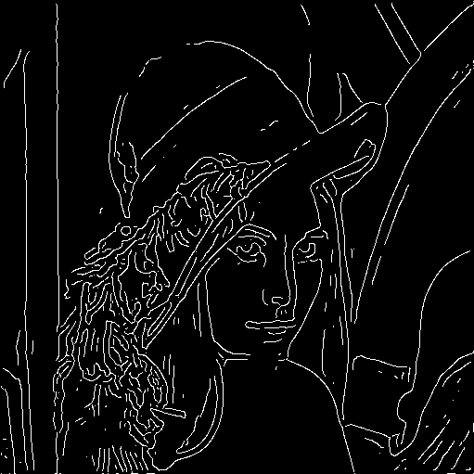
Finding edges
thinning
(non-maximum suppression)

Slide 15
Canny Thresholding
Low thresholds create more edges, but at the cost of more spurious edge pixels
Canny proposes a two-level threshold
Edge pixel’s gradient magnitude must be above low threshold, and connected to an edge pixel
Start by keeping (classifying as edges) all candidates above high threshold
Recursively, if pixel above low threshold and adjacent to an edge pixel keep it

Slide 16

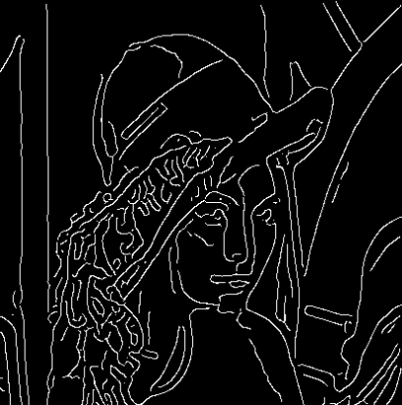
Summary: Canny edge detector
Filter image with derivative of Gaussian
Find magnitude and orientation of gradient
Non-maximum suppression
Linking and thresholding (hysteresis)
Source: D. Lowe, L. Fei-Fei

Slide 17
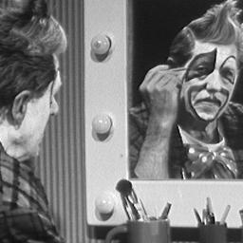
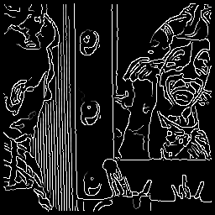
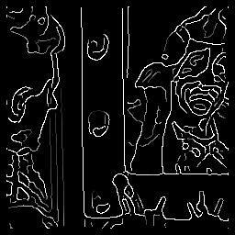


Canny edge detector
original
Canny with
Canny with
Need to set sigma, low threshold, high threshold
The choice of sigma depends on desired behavior
Large sigma detects “large-scale” edges
Small sigma detects fine edges
Source: S. Seitz

Slide 18
Implementation issues
The rectangular pixel grid creates subtle issues when computing discrete derivative estimates
Estimates are at different points in each direction if use x,y directions
2
1
2
3
1
0
1
2
1
0
1
2
2
1
2
3

Slide 19
Estimating Discrete Gradient
Gradient at u,v with 45° axes
Down-right: ∂I/∂x’ ≈ I[u+1,v+1]-I[u,v]
Down-left: ∂I/∂y’ ≈ I[u,v+1]-I[u+1,v]
Handle image border, e.g., no change
u,v
u+1,v
u,v+1
u+1,v+1
2
1
1
2
4
6
5
0
0
6
5
5
16
72
50
25
7
6
7
6
-1
1
0
0
0
-5
-1
1
1
26
1
1
1
6
7
7
1
1
-1
0
0
-4
-5
0
1
17
26
0
2
2
7
6
0
0
0
0
0
0
0
0
0
0
0
0
I
∂I/∂x’
∂I/∂y’
⎟⎜I⎟⎜²

Slide 20
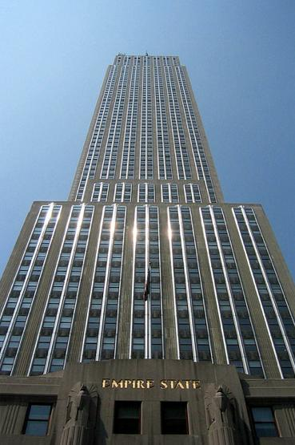
Using edge detection
Many edge detectors have been developed
Most popular are Sobel (very simple) and Canny (more sophisticated)
All are imperfect because edge detection is an ill-defined task
How to use edge detectors for something useful?
Must be robust to small differences in edge detector output

Slide 21
Finding straight lines
Challenges: some edge pixels are missing, much background clutter, multiple lines

Slide 22
Model fitting
Robustly fitting a model to data is a recurring theme in computer vision

Slide 23
Model fitting
Robustly fitting a model to data is a recurring theme in computer vision

Slide 24
Finding straight lines
Challenges: some edge pixels are missing, much background clutter, multiple lines
One solution: try all possible lines and count how many points each line passes through
choose line with most support
The Hough transform provides
an efficient way of doing this

Slide 25
Hough Transform
Basic idea: Every pixel casts a vote for all of the lines that could have generated it
Tabulate votes to find most likely line(s)
Voting is conducted in a parameter space
For lines, we could parameterize in terms of slope and y-intercept, i.e. y=mx+b
y
b
which lines intercept this point?
x
m

Slide 26
Hough Transform
Basic idea: Every pixel casts a vote for all of the lines that could have generated it
Tabulate votes to find most likely line(s)
Voting is conducted in a parameter space
For lines, we could parameterize in terms of slope and y-intercept, i.e. y=mx+b
y
b
x
m

Slide 27
Hough Transform
Basic idea: Every pixel casts a vote for all of the lines that could have generated it
Tabulate votes to find most likely line(s)
Voting is conducted in a parameter space
For lines, we could parameterize in terms of slope and y-intercept, i.e. y=mx+b
Intersection point gives
parameters of best fit line
y
b
x
m

Slide 28

Better parameterization
A better parameterization is to use polar coordinates, to avoid unbounded slope (m)
Equation of a line is then
A point in image space corresponds with a _____ in Hough space
y
ρ
x
θ

